Slide 1
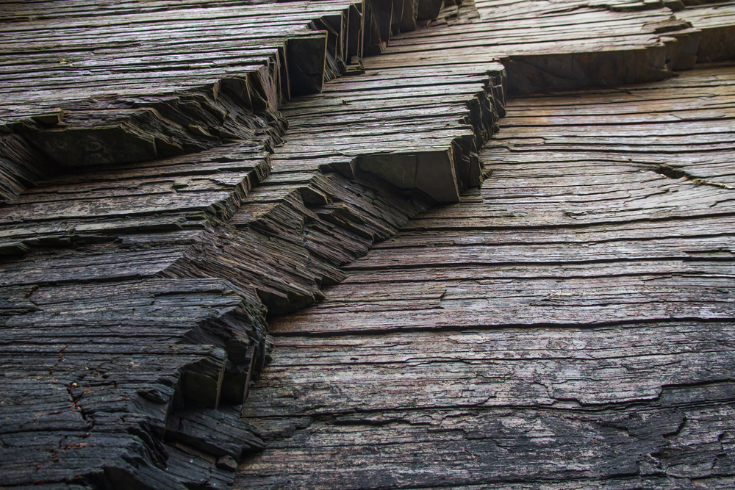
Shale gas and fracking: fact and fiction
Mike Stephenson
British Geological Survey
Notes:
Highlight science at the BSA festival

Slide 2
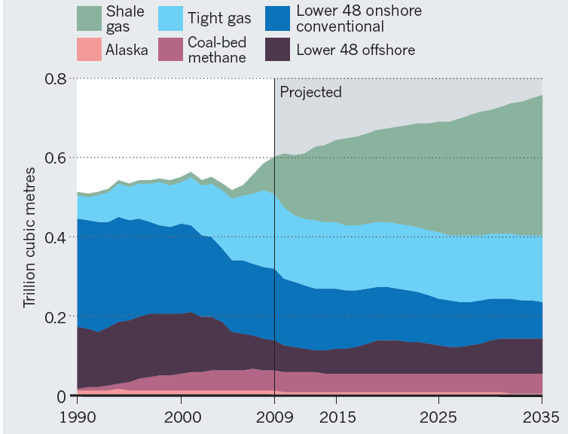
Fact
Fact
Source: Nature Sept 2011
Notes:
There are very few undisputed facts. Leave it at desciebing the ‘fact’

Slide 3
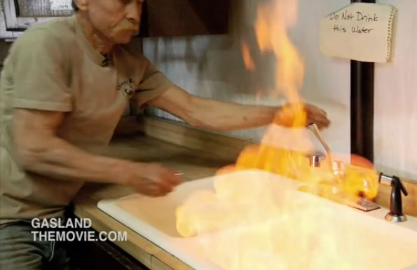
Fact?
Fact?
Methane in domestic water supplies from fracking?
…or natural methane?
Notes:
Shale gas as a subject is made up of contestable chunks of subject matter

Slide 4

Fact?
Cracks in a bridge from earthquakes caused by fracking
…or cracks that were already there

Slide 5
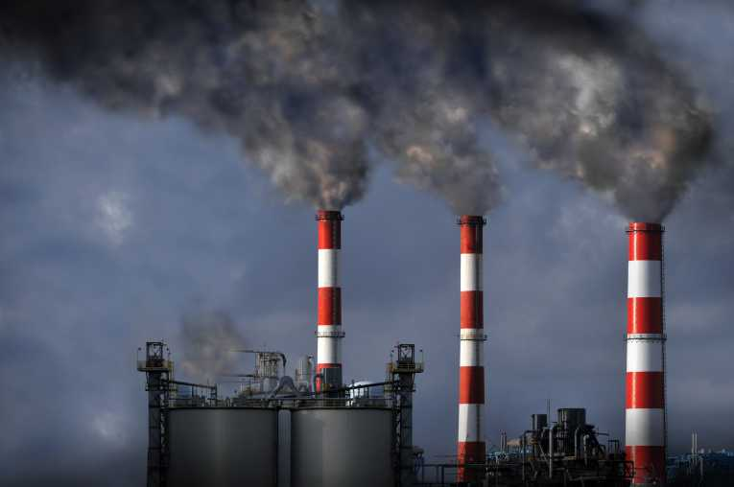

Fact?
2006 to 2011, CO2 from fossil fuels declined by 7.7% due to substitution of shale gas for coal in power stations
…but more greenhouse gas emissions due to ‘fugitive emissions’ of methane associated with fracking?

Slide 6
Contestable areas in shale gas
Does shale gas use too much water?
Do shale gas wells contaminate groundwater?
Does fracking cause dangerous earthquakes?
Does shale gas cause subsidence?
Does fracking produce dangerous radioactivity?
Is shale gas lower carbon than coal?
Shale gas

Slide 7


The science gauge
Peer reviewed scientific papers and projects can provide a ‘meter reading’
TRUE
FALSE
I’m going to show you how the ‘science gauge’ can be applied to some of these contestable issues.
Notes:
The science meter can be applied to the contestable chunks of subject matter in shale gas

Slide 8
Some shale and fracking basics

Slide 9
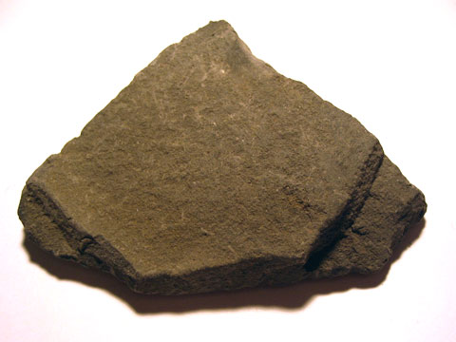
Shale
Grey or black, soft
Fine grained
70% of the world’s surface rocks are sedimentary; 50% of those are shale
Lots of organic matter (up to 10%)
1 mm

Slide 10
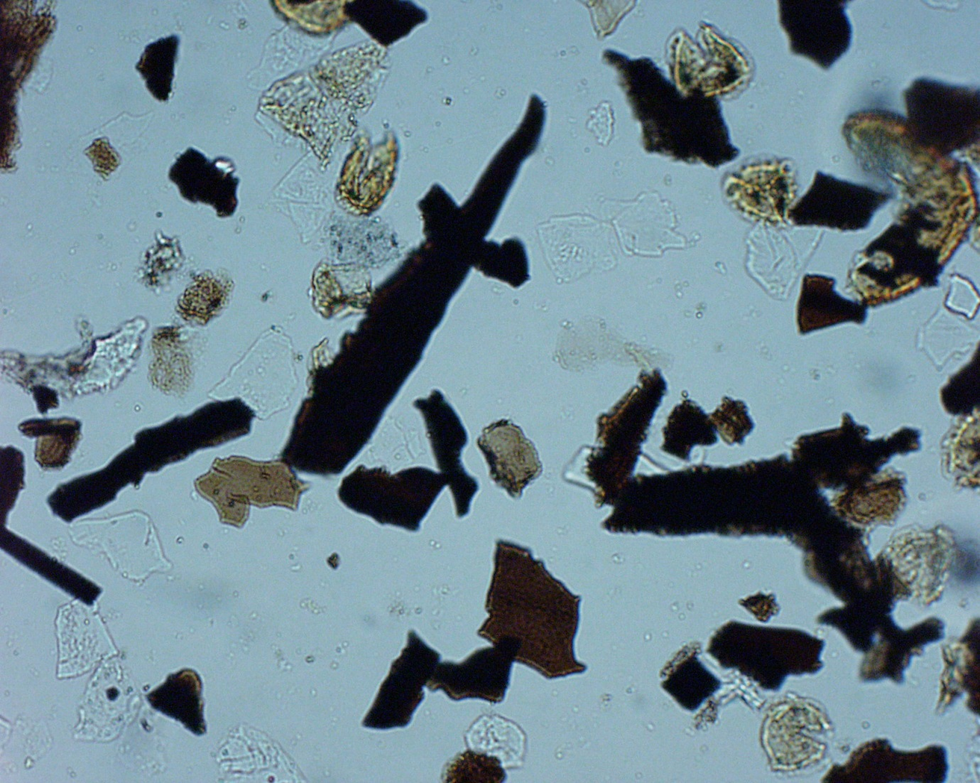
0.5 mm across

Slide 11
Where the organic matter comes from

Slide 12
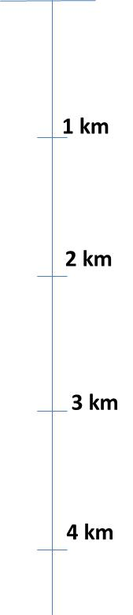
Mud
Mud
Shale
Shale burial makes gas

Slide 13
Gas in sandstone and shale
Shale grains
gas
sand grain
gas
shale
sandstone
1 mm

Slide 14




Fracking
Shale layer
Cracks the shale
High pressure water or nitrogen, 350-700 bar
Sand pumped in to hold cracks open

Slide 15
Credible regulation

Slide 16
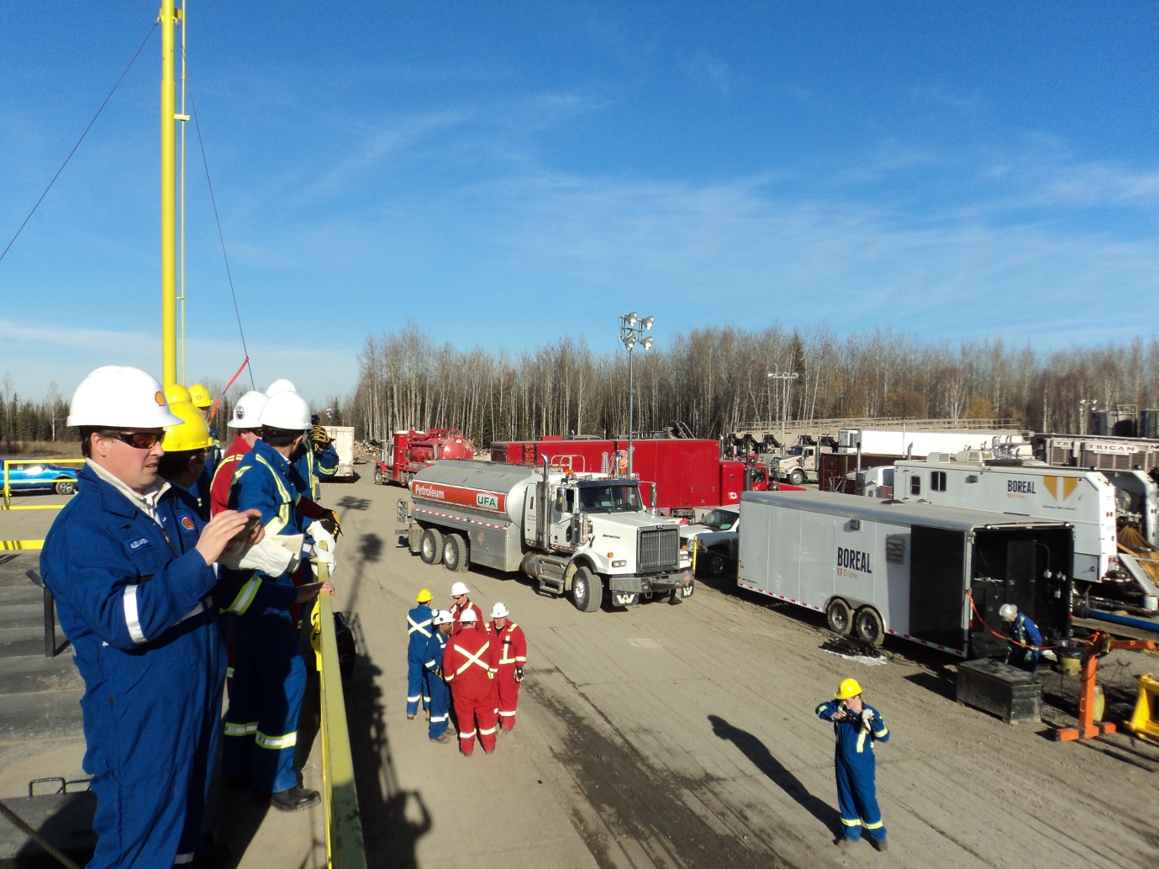
Fracking site in Alberta
From Shale gas extraction in the UK: a review of hydraulic fracturing. The Royal Society and The Royal Academy of Engineering, Report DES2597.

Slide 17
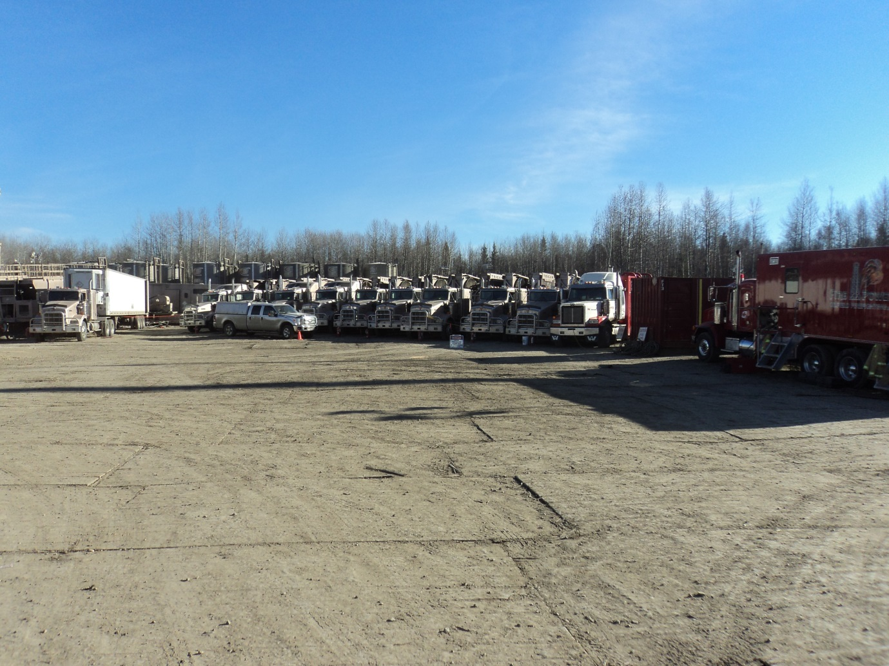
Frack trucks

Slide 18
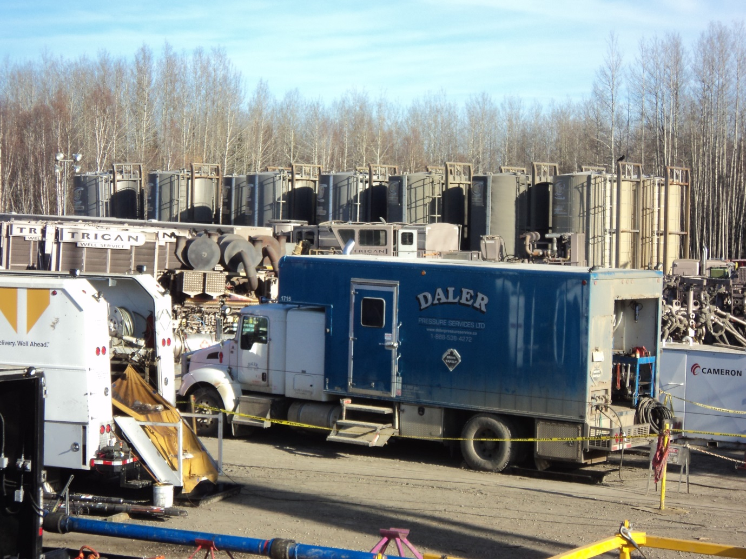
Flowback tanks
Notes:
Mnetion flow

Slide 19
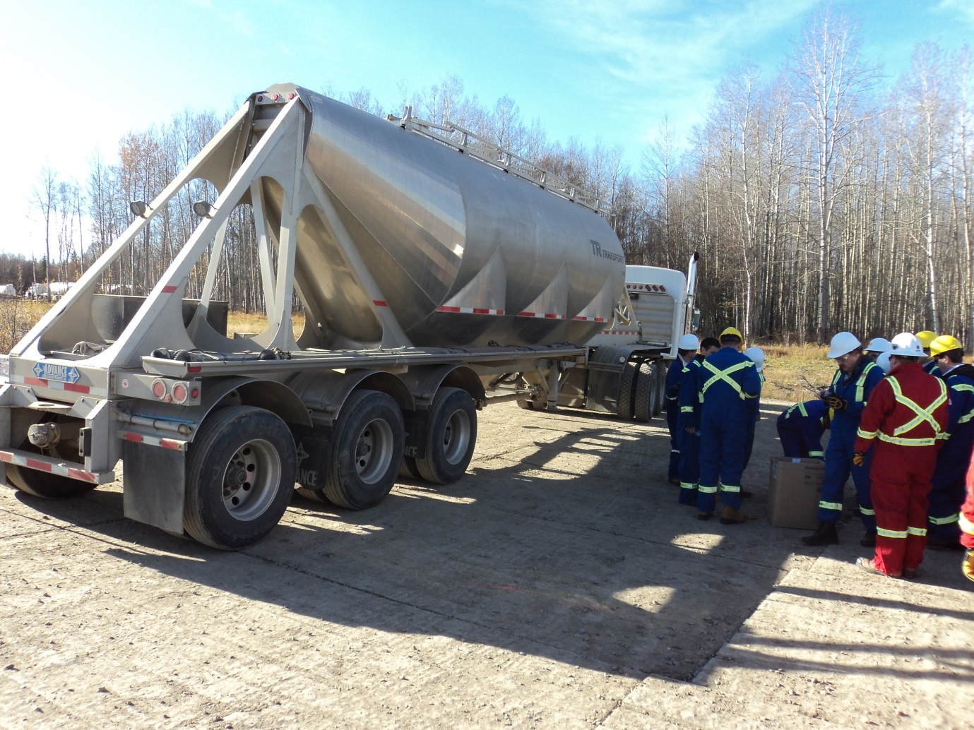
Truck carrying proppant

Slide 20
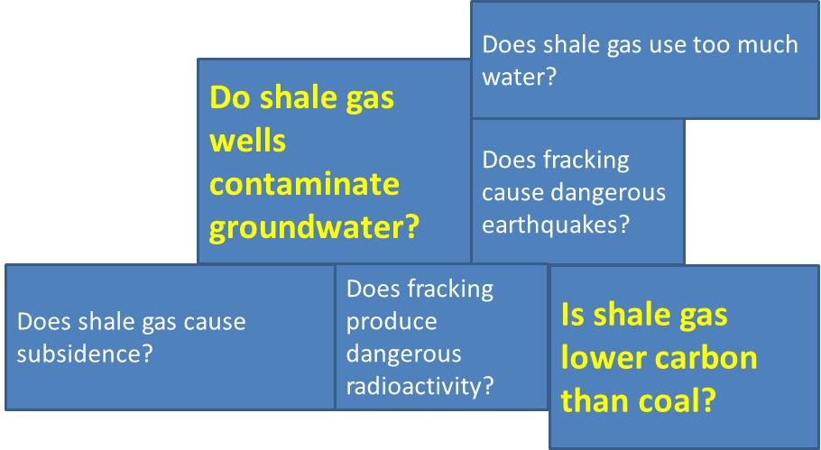
Do shale gas wells contaminate groundwater?
Some basics
TRUE
FALSE

Slide 21

Types of underground methane
Shale gas well
Water wells
Water wells
biogenic methane released by bugs
Thermogenic methane released by fracking
Shale
Notes:
Biogenic and thermogenic – d13C the way of telling them apart
Methane could be naturally occurring in the rock, before you test you have to know if there’s already methane there.
Methane moderately soluble, 0.054 µg/l,
increase at higher pressure
Natural methane in groundwater
Chalk 0.05–42.9 µg/l,
Triassic sandstone 0.05–465 µg/l
Different sources of thermogenic – stored gas, native gas

Slide 22
Distinguishing biogenic and thermogenic
Notes:
Biogenic/bacterial (e.g. wetland, landfill) – high C₁/C₂₊ ratio, low δ¹³C values
Thermogenic (e.g. natural gas, coalbed methane) – low C₁/C₂₊ ratio, higher (less negative) δ¹³C values

Slide 23
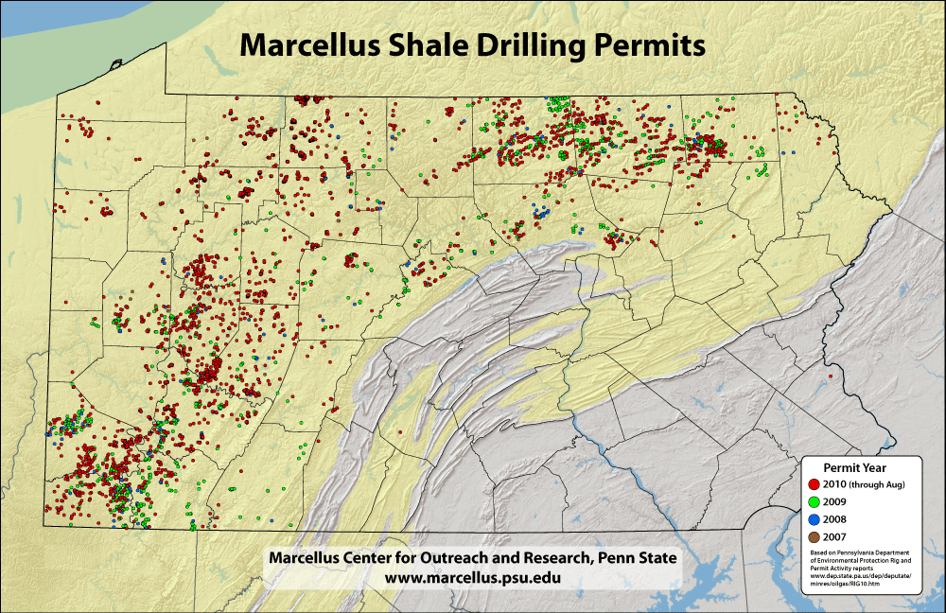
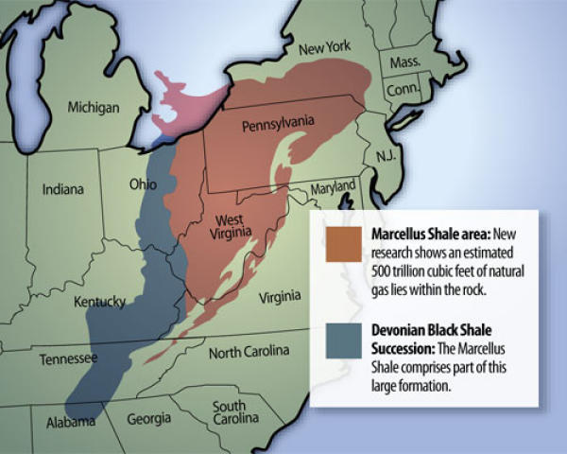
Marcellus, Pennsylvania

Slide 24
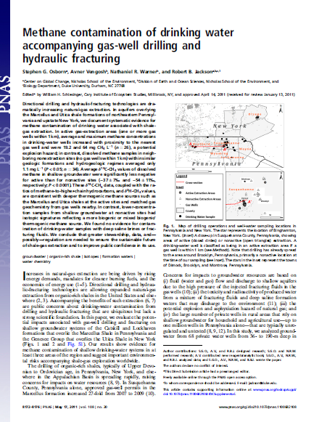
Contamination from fracking?
Osborn et al. 2011, Duke University
Measured methane content and δ¹³C
Higher methane concentrations in water wells close to shale gas wells
δ¹³C suggests thermogenic
Authors then say ‘likely to be shale gas from the fracking’

Slide 25
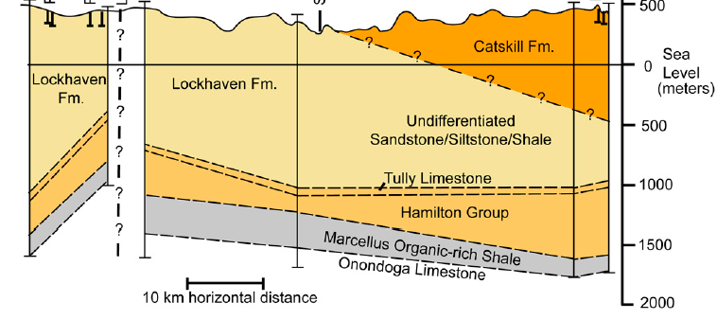
Water wells and shale wells
Shale well
Water wells
Shale well
Lots of criticism because the authors didn’t know how much natural methane there was in water wells before fracking…
and because the sample size was small
Notes:
Gas wells are very deep 1500m
Water wells shallow 100m

Slide 26
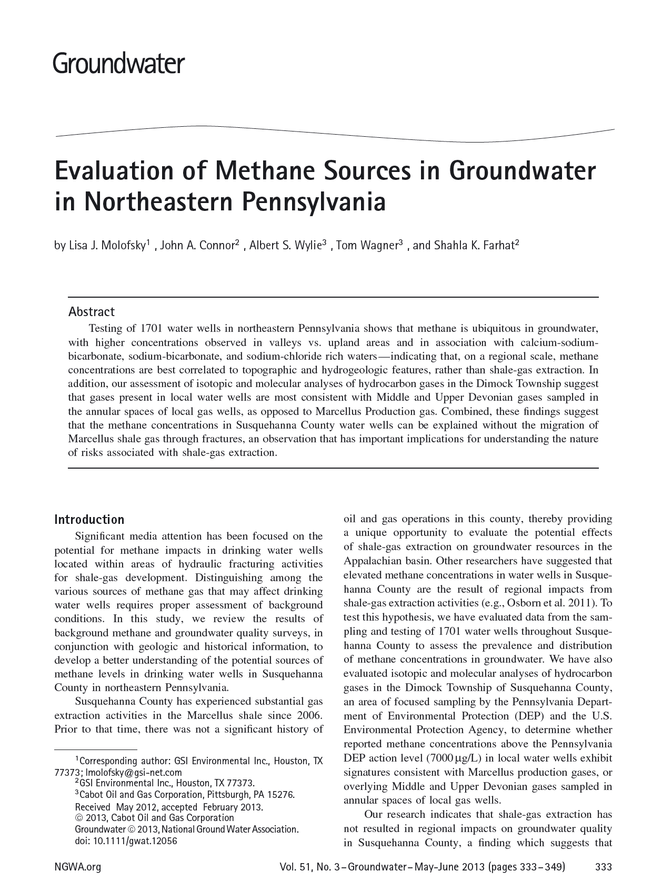
Thermogenic methane unrelated to fracking?
Molofsky et al. 2013
Looked at some of the Osborn et al data
Also at baseline water data: historical records show flammable and effervescing natural springs and water wells back to the late 1700s.
Dec 2011

Slide 27
Thermogenic methane related to topography?
Molofsky et al. (2013).

Slide 28
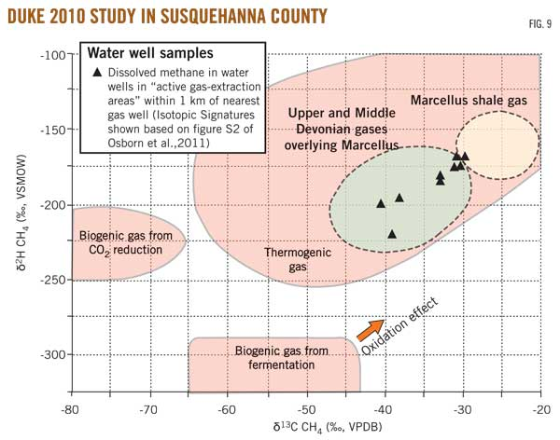
Methane signature indicates layers above Marcellus
Molofsky et al. 2011

Slide 29
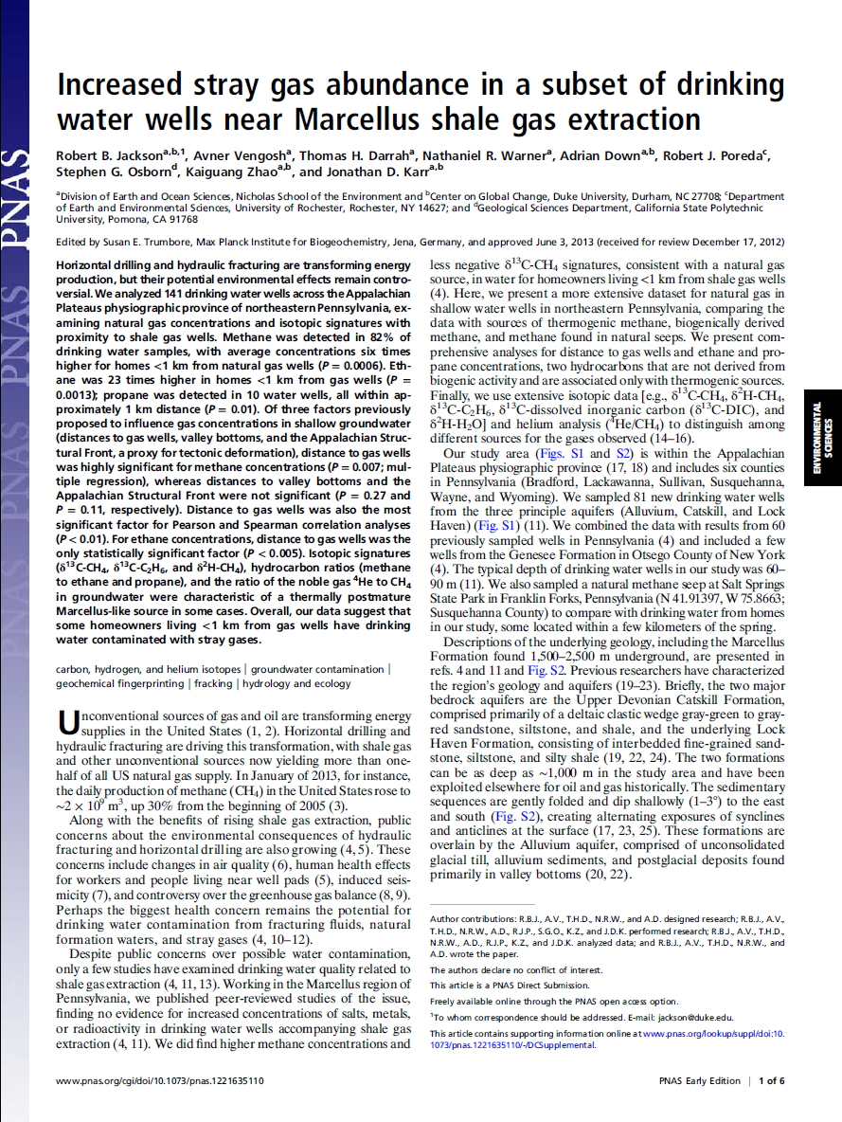
Another look at the water wells
Jackson et al. 2013
Duke University Group
Statistically significant evidence
141 water wells studied
methane concentrations six times higher for water wells within 1 km of shale gas wells
No correlation with topography (valleys)

Slide 30
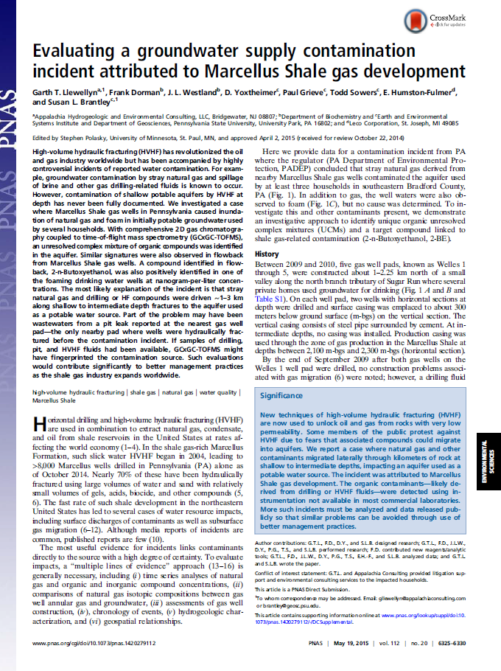
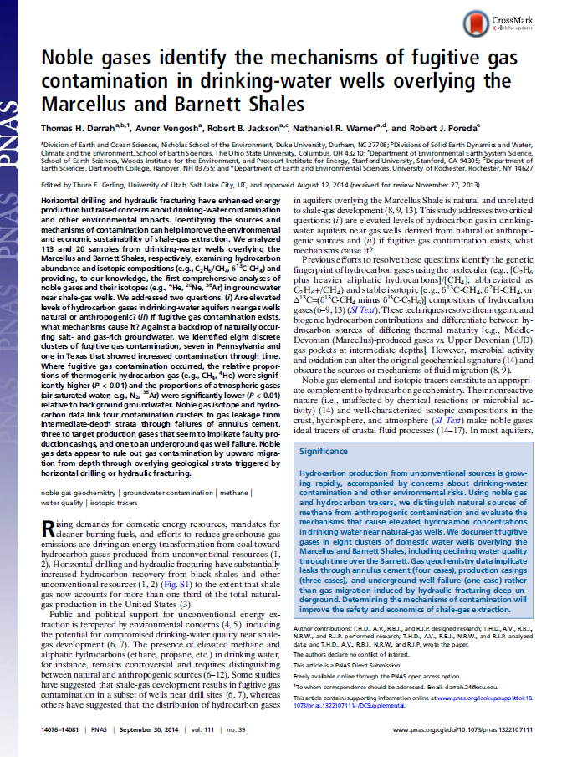
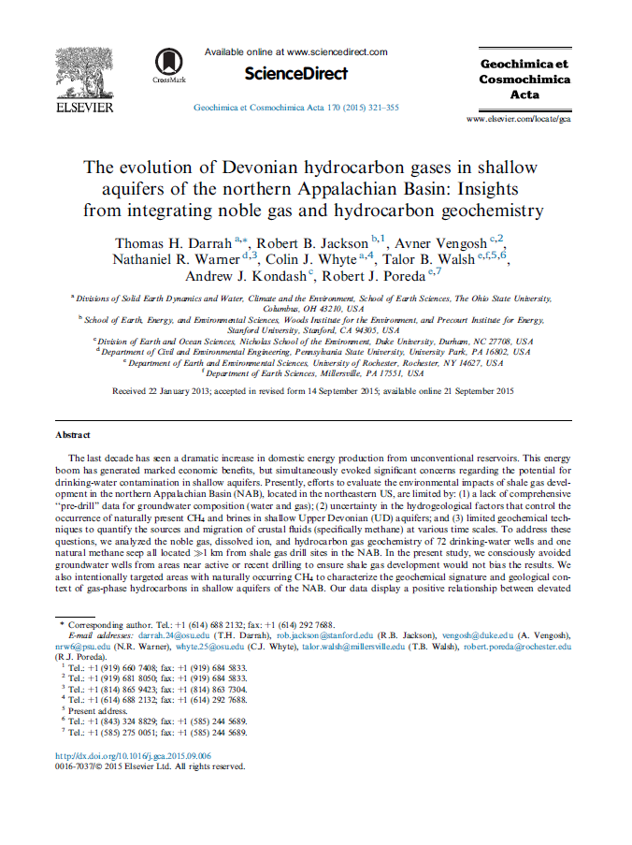
Llewellyn et al. 2015
groundwater supply contamination incident
additives probably derived from drilling or hydraulic fracturing fluid were present in groundwater
Darrah et al. 2014
Noble gas and methane
Suggests leakage at intermediate depth due to casing and cement problems
Darrah et al. 2015
Noble gas, methane and other geochemistry
Outside shale gas areas
Diffusison of deep shale gas into shallow aquifers helped by neotectonic fracturing

Slide 31

Leaking wells
Pennsylvania summary
Shale gas well
Natural
Water well
Water well
Water well
Fault
Fault
Diffusion
Other shale layers
Marcellus shale
Notes:
Who’s right? Probably they’re both right…

Slide 32
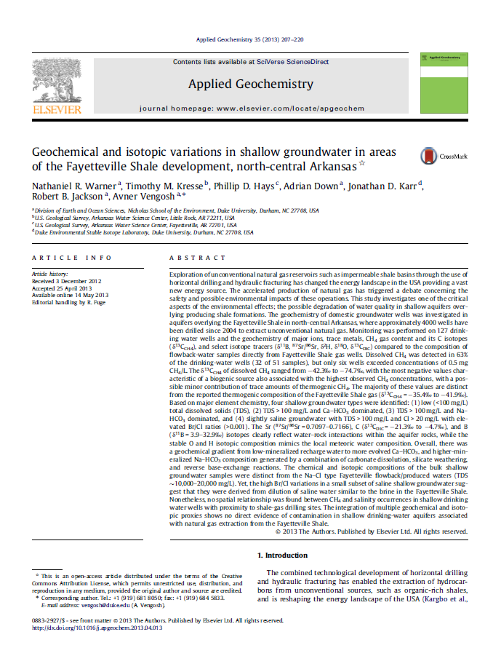
Outside Pennsylvania
Duke University Group
127 drinking water wells
Fayetteville shale 4000 wells drilled since 2004
very low concentrations of methane
biogenic, not thermogenic
δ¹³C of the gas in the water wells was also distinct from the δ¹³C of the Fayetteville shale gas
Shale gas wells do leak but only a small number…
And mostly in Pennsylvania….
Water contamination most likely from leaky wells - not fracking

Slide 33
Is shale gas ‘lower carbon’ than coal?
Some basics
TRUE
FALSE

Slide 34
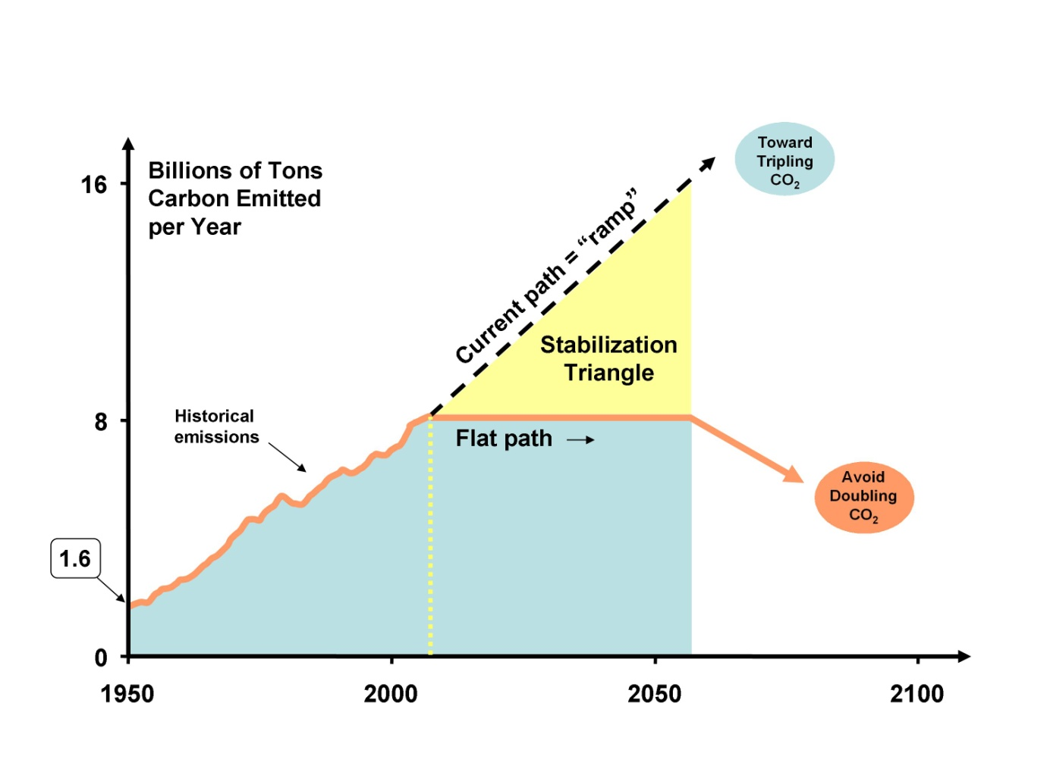
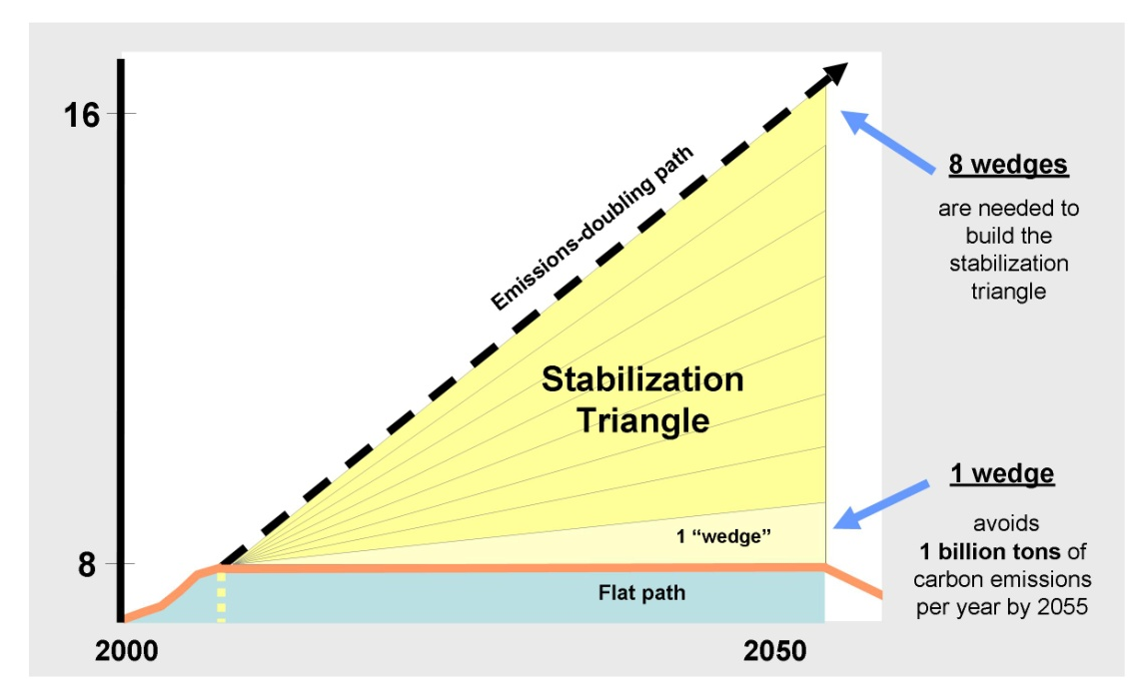
Context
Pacala and Socolow R 2004
If 1400 natural gas power stations were substituted for an equal number of coal-fired power stations then this would save one wedge of CO2 emissions

Slide 35
Source US EIA

Slide 36
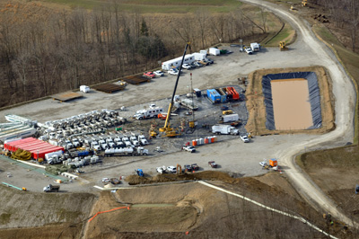
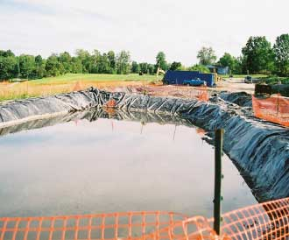
Open flowback tanks
But what about methane?

Slide 37
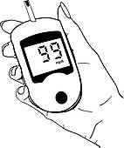

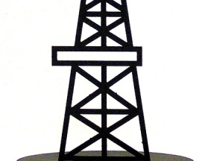
‘Fugitive’ emissions
Emissions from tank
On the ground direct measurements
Shale gas well
Shale layer
Notes:
Biogenic and thermogenic
Methane could be naturally occurring in the rock
Methane moderately soluble, 0.054 µg/l,
increase at higher pressure
Natural methane in groundwater
Chalk 0.05–42.9 µg/l,
Triassic sandstone 0.05–465 µg/l
Different sources of thermogenic – stored gas, native gas

Slide 38
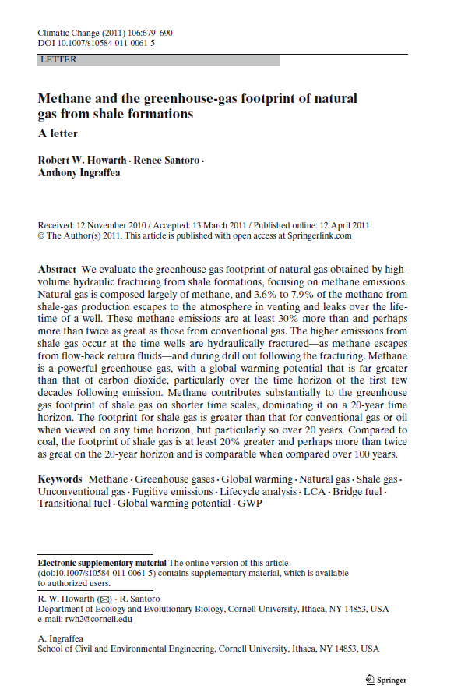
Howarth et al. 2011 (Cornell Uni)
direct measurements
3 to 8% of the total methane production escapes to the atmosphere through the lifetime of every shale gas well
This is enough leaking gas to really make a difference
Is shale gas is worse than coal?

Slide 39
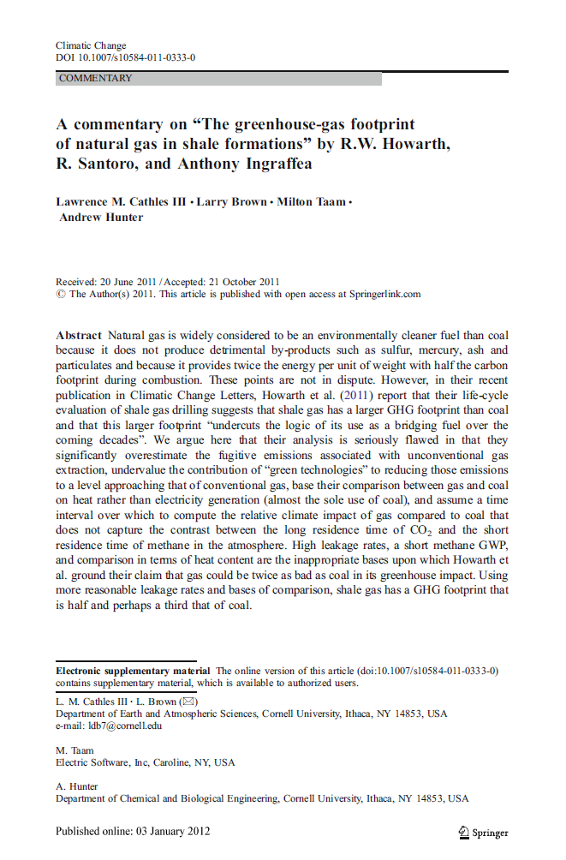
Cathles et al. 2012 (Cornell Uni) rebuttal
High leakage rates of Howarth unrepresentative?
(ten tests of wells drilled into the Haynesville shale)
Source (mainly scientific papers and reports) | Shale layer | Volume of Gas released during flowback (thousands of cubic metres per well)
Jiang | Marcellus | 603
Howarth | Haynesville | 6800
Howarth | Barnett | 370
EPA | Various | 260
O’Sullivan and Paltsev | Haynesville | 1180
O’Sullivan and Paltsev | Barnett | 273
O’Sullivan and Paltsev | Fayetteville | 296
O’Sullivan and Paltsev | Marcellus | 405
O’Sullivan and Paltsev | Woodford | 487
from McKay and Stone (2013).

Slide 40
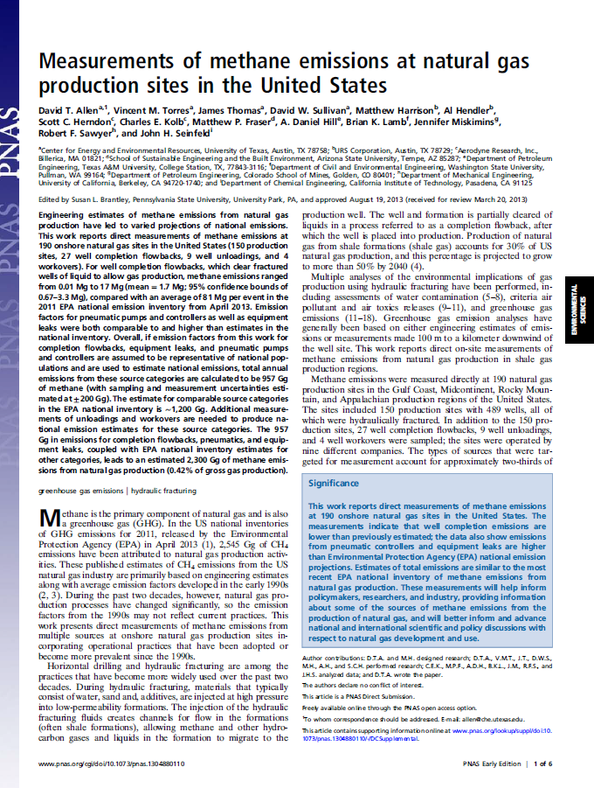
Allen et al. 2014 (Uni Texas)
Direct measurement of 190 shale gas sites all over the US
leakage rate is about half of one percent of gas production,
much less than the 3 to 8% estimated by Howarth
Howarth et al
3 to 8%
Allen et al
<0.5%

Slide 41
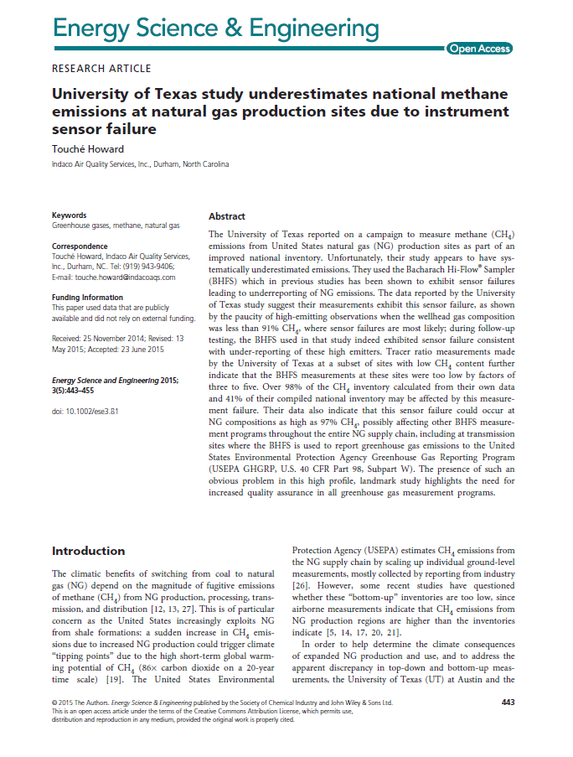
Howard (2015)
Allen et al. 2014 underestimated emissions
They used the Bacharach Hi- Flow® Sampler which in previous studies has been shown to exhibit sensor failures
The BHFS measurements at these sites were too low by factors of three to five

Slide 42

Yes, in Pennsylvania, but in a small number of cases
Fracking doesn't seem to cause it directly
Other areas of the USA don’t seem to be affected
It might be to do with the cement completion of the well
Jury’s out

Slide 43
Conclusions
The ‘science gauge’ can be applied to the contestable issues in shale gas
Science is important to society and not just big telescopes and synchrotrons!

Slide 44
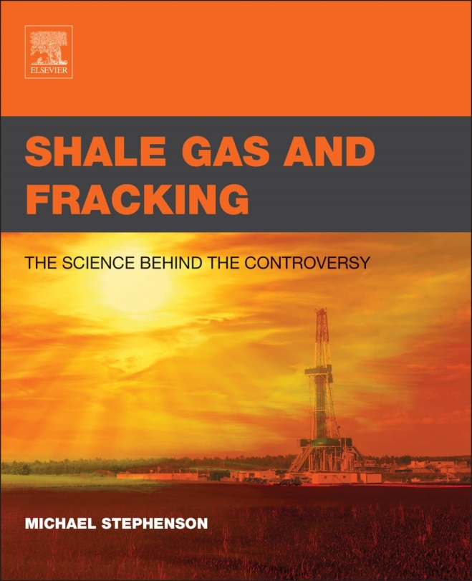
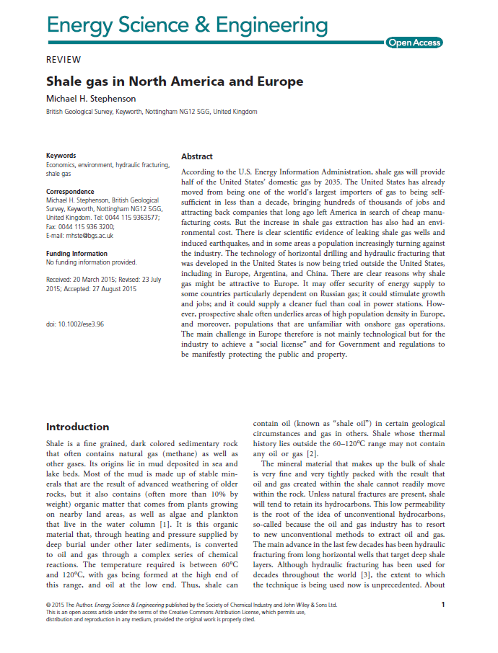
New book out now
Free summary paper
TRUE
FALSE

